Slide 1

Tracking the Weaponization and Manipulation of Cultural Heritage in Ukraine by Russia
Hidri Mohamed Hedi Supervisors: Hamest Tamrazyan, Emanuela Boros

Slide 2
Weaponisation of cultural heritage
• Using cultural heritage as a strategic tool for political and ideological gain
• Deliberate manipulation, distortion, or reframing of cultural narrative
• Aims to bolster political claims and undermine opposition
• Involves reinterpreting history and identity to serve strategic objectives

Slide 3
Weaponisation in the Context of the Ukraine War
• Rewriting historical narratives to legitimize territorial claims
• Use of loaded language and biased framing to discredit Ukrainian heritage

Slide 4
examples of weaponisation terms and narratives:
• Term (Ukraine’s Perspective): "Russian occupation of Crimea"
• Term (Russia’s Perspective): "Crimea’s reunification with Russia"

Slide 5
Data Sources & Resources
• Wikimedia API: Real-time monitoring of Wikipedia editing histories
• Analysis of Wikipedia Talk Pages to uncover editorial disputes
• Web scraping for supplementary metadata and content
• Diff algorithms to compare successive revisions
• Integration with large language models (LLMs) for semantic analysis

Slide 6
Data Collection Example
{"version": "diff", "Timestamp": "2024-10-12T03:49:02Z", "User": "88.119.161.23", "Comment": "/* Music */", "Diff": "--- \n+++ \n@@ -139,7 +139,7 @@\n Today in use there are two types of alphabet: Cyrillic and Latin. Initially Crimean Tatars used Arabic script. In 1928 it was replaced with the Latin alphabet. Cyrillic was introduced in 1938 based on the Russian alphabet. The Cyrillic alphabet was the only official one between 1938 and 1997. All its letters coincide with those of the Russian alphabet. The 1990s saw the start of the gradual transition of the language to the new Latin alphabet based on the Turkish one.}

Slide 7
The LLM Analysis
• Custom prompt to detect weaponised language and framing
• Extracts indicators (loaded terms, bias, political rhetoric)
• Classifies edits into "Weaponised" vs. "Not Weaponised"
• Ensures consistency in evaluating ideological manipulation

Slide 8
Record 8268 (Version: diff):
**Judgment: Weaponised**
**Explanation:**
The revision made by the user "FadelAliKuznetsov" involves the removal of a line stating that the famine's impact "persists to this day." The comment indicates that this line was removed due to a perceived lack of proof. This action reflects a subtle shift in the narrative surrounding the Holodomor, which is a sensitive topic tied to Ukrainian cultural heritage and identity.
The removal of this line can be interpreted as an attempt to downplay the ongoing effects of the Holodomor on Ukraine, which could serve to diminish the historical significance of the event in the context of Ukrainian nationalism and cultural memory. By questioning the validity of the statement regarding the famine's lasting impact, the revision aligns with narratives that may seek to undermine the recognition of the Holodomor as a genocide against Ukrainians, a point of contention in the broader discourse surrounding Ukrainian-Russian relations.
The language used in the comment ("due to no proof") suggests a dismissive tone towards the historical consequences of the famine, which can be seen as an effort to reframe the narrative in a way that may benefit a particular political agenda. This aligns with the weaponization of cultural heritage, where historical events are manipulated to serve contemporary political narratives.

Slide 9
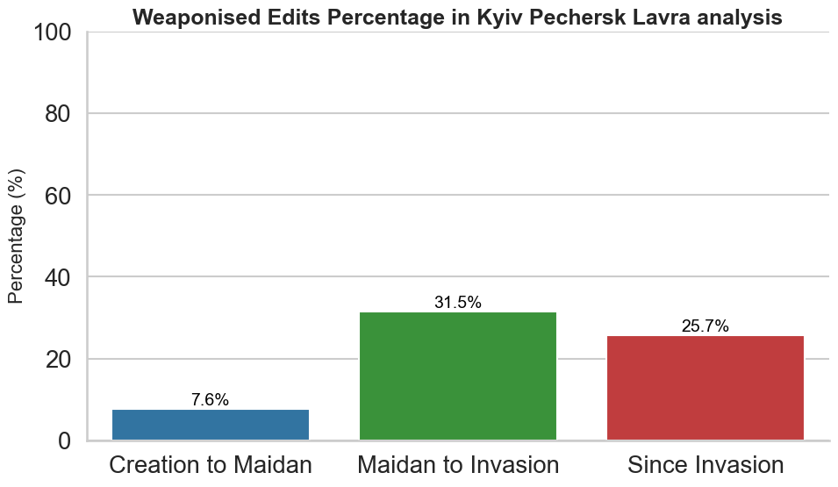
Results

Slide 10
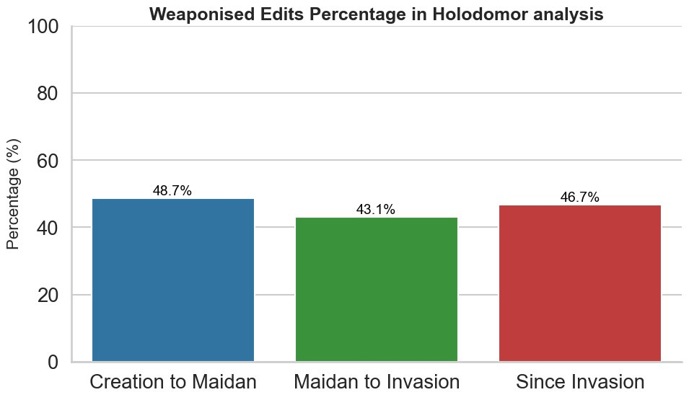

Slide 11
